Slide 1
Analysis of 2006 Pike’s Peak 10K Race
By Harsha Goonewardana, Data Scientist

Slide 2
Table Of Contents
Data overview
2. Descriptive statistics with a gender focus
3. Comparison of race measurement metrics
4. Chris Doe performance: a comparative measurement
5. Divisional segmentation
https://press.atairbnb.com/fast-facts/

Slide 3
Data Overview

Slide 4
Overview - 2006 Pike’s Peek 10K dataset
Two text files of data for male and female participants
Nine features and 2370 observations
Extensive data engineering was required during the preprocessing stage
Feature engineering included:
Creating timedelta objects
Remapping of divisions from 257 to 17
Removal of miscoded data
https://press.atairbnb.com/fast-facts/

Slide 5
Descriptive Statistics

Slide 6
Measurement of race results
Gun Time : Currently, gun time is the only method of measuring time that's sanctioned for official use by the United States Track and Field Association (USATF).*
Net Time : Net Time, Chip Time, or Mat to Mat Time is a personal time and is based on the difference in time measured by a RFID chip issued to the runner.*
There is some debate on the best measure, so both have been included in the interest of completeness.
*https://www.flrunning.com/blog/chip-time-vs-gun-time-what-is-it-and-why-the-controversy-14105

Slide 7
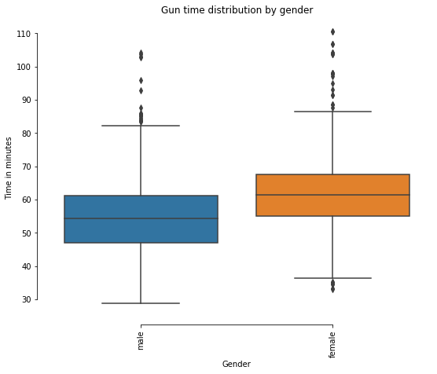
Gender Segmentation - Gun Time in Minutes
 | Male | Female
Minimum | 28.80 | 32.98
Median | 54.30 | 61.33
Mean | 54.62 | 61.70
Inter - Quartile Range | 47.0 - 61.12 | 54.92 - 67.53
Mode | 55.22 64.93 (bi-modal) | 61.78 62.67 (bi-modal)
Maximum | 104.12 | 110.52

Slide 8
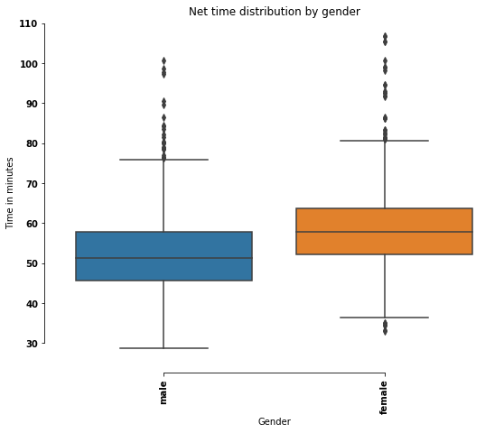
Gender Segmentation - Net Time in Minutes
 | Male | Female
Minimum | 28.78 | 32.97
Median | 51.37 | 57.82
Mean | 54.62 | 61.70
Inter - Quartile Range | 45.68 - 57.82 | 52.22 - 63.6
Mode | 55.22 64.93 (bi-modal) | 61.78 62.67
Maximum | 100.63 | 106.82

Slide 9
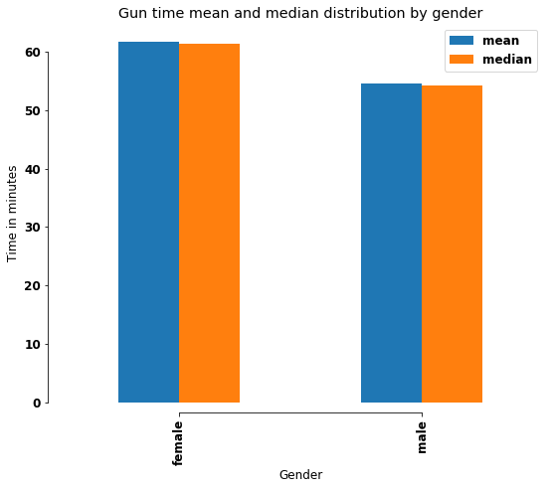

Mean and Median Distribution
The mean and median for all distribution are similar indicating a normal distribution of values

Slide 10
Gun time comparison- Gender
41% of males were faster than the mean time of females and 11% of females were faster than the mean time of males.

Slide 11
Net time comparison- Gender
35% of males were faster than the mean time of females and 12% of females were faster than the mean males.

Slide 12
Comparison of Race Measurement Metrics
Gun time vs Net time

Slide 13
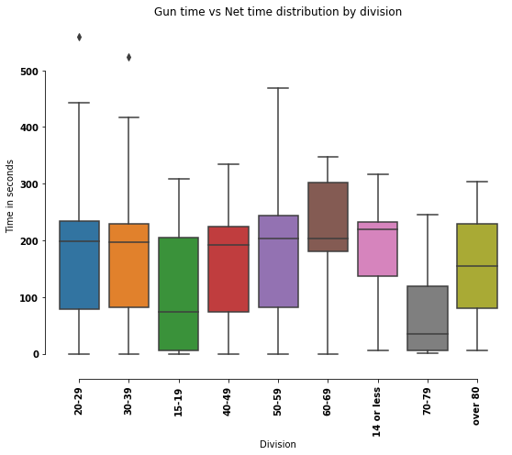
The 70-79 division has the lowest difference between Gun time and Net time

Slide 14
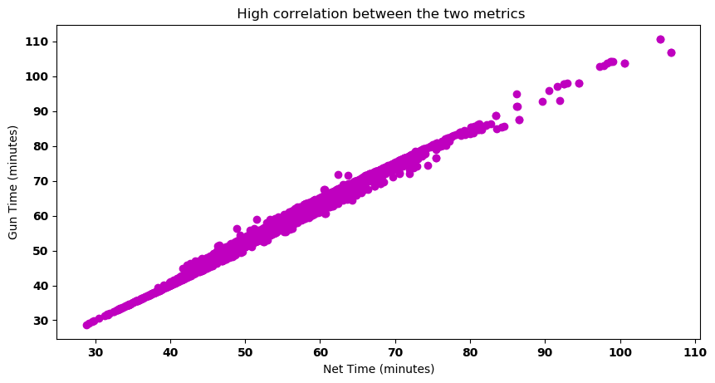
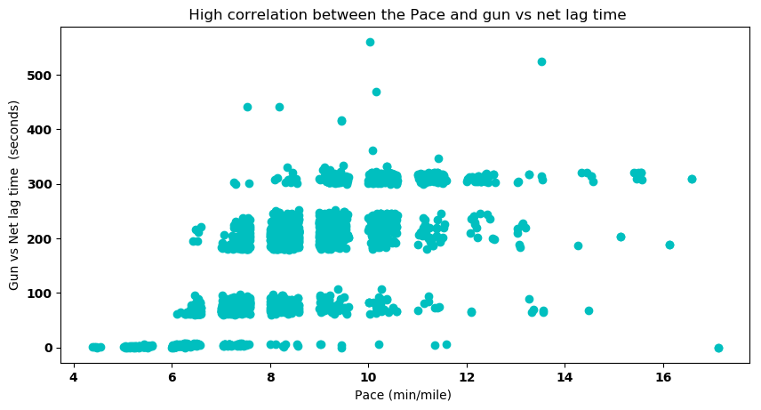
The high correlation between Pace and lag time as well as the high correlation between the metrics indicate that the fastest qualifiers were clustered near the front of the race as expected.

Slide 15
Does using Gun time or Net time make a difference? NO
Placement - Male
Placement - Female
 | Gun Time | Net time
Joshua Kemei | 1 | 1
George Kirwa Misoi | 2 | 2
Jacob Frey | 3 | 3
Gurmessa Kumsa | 4 | 4
Mike Baird | 5 | 5
 | Gun Time | Net time
Florence Jepkosgei | 1 | 1
Eunice Chepkirui | 2 | 2
Elena Orlo | 3 | 3
Susannah Kvasnicka | 4 | 4
Casey Smith | 5 | 5

Slide 16
Chris Doe 44 years old 535th place 40-49 Male division

Slide 17
Compared to the top 10%:
In minutes
Gun Time: 53.12
Slower by 10.3
Net Time: 49.72
Slower by 8.03

Slide 18
Divisional Segmentation

Slide 19
Remapped Distribution Table
Division | Male | Female | Total
14 or less | 26 | 13 | 39
15-19 | 45 | 26 | 71
20-29 | 144 | 228 | 372
30-39 | 346 | 420 | 766
40-49 | 415 | 283 | 698
50-59 | 205 | 104 | 309
60-69 | 69 | 24 | 93
70-79 | 9 | 3 | 12
Over 80 | 2 | 0 | 2

Slide 20
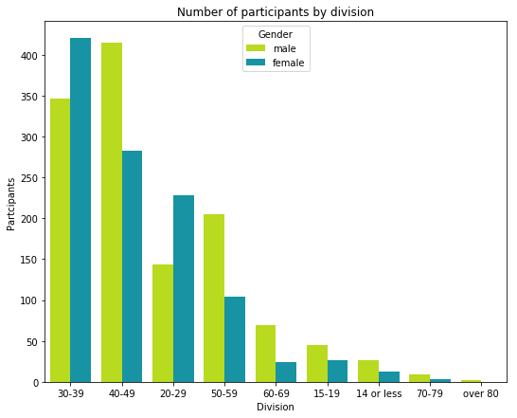
Participant distribution across divisions
30-39 group had the most participant while 70-79 and 80+ had the least.
All groups except 30-39 and 20-29 showed more male participants than female.

Slide 21
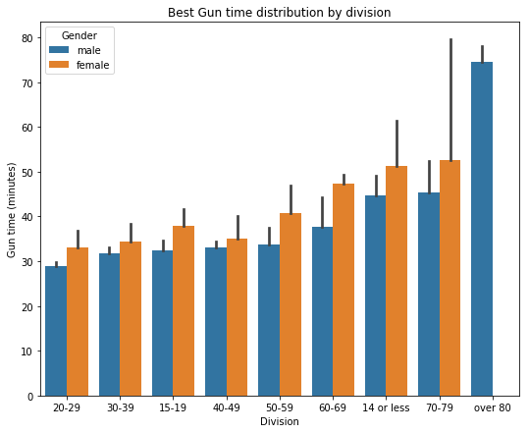
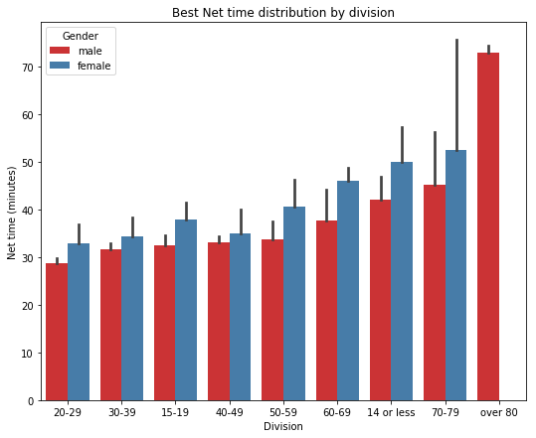
Best time distribution by division
In both the metrics, 20-29 and 30-39 divisions show the lowest time while older and younger divisions have longer times.

Slide 22
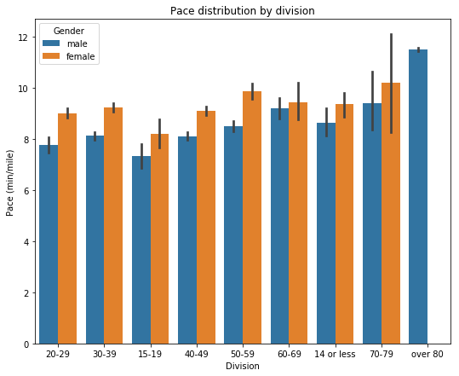
Pace distribution shows that across all divisions, males posted better pace times than females and the 15-19 division had the best pace.

Slide 23
Thank you!

